Slide 1
MIS 710 – Process Innovation and Management
1. BPM / Productivity
Part I --Introduction to Business Process Management
Evolution of technologies and process improvement
Organizational & managerial processes framework
Part II -- Productivity
Work and productivity trends
Defining & measuring productivity
    Economic (Efficiency definitions & DEA)
    Accounting (Activity-based Costing)
    Financial (EVA and DCF)
The IT Productivity Paradox
Notes:
This course is about designing organizations and processes.
Processes are the means through which work gets done. (Good people can’t overcome poor processes (Peter Keen)
Often the design approach will involve the use of IT. But people are just as important. We will try to take a balanced view.
How do we know if an organization is more efficient? More effective?
(Both efficiency & effectiveness are important, but many “efficient” organizations are now out of business.
In this lecture, we concentrate on how we can measure the efficiency (productivity) of organizations and processes. Unless we can measure improvement, we can not tell if our design intervention has been useful.
Three approaches to answering this question:
Economist’s - Data Envelopment Analysis
Accountant’s - Activity-based Costing (ABC)
Financial - ROI and Economic Value added (EVA)

Slide 2
History: Technology Waves
Electronic Commerce
Hype
Cumulative IT Value
BIG DATA
Value
Data
Processing
MIS
Decision
Support
Systems
Expert
Systems
Business
Process
Reengineering
Business Intelligence
Social Networks
IOT
TQM
Knowledge Management
Blockchain
Cloud
© E. A. Stohr, 2013
Notes:
What’s good and bad in all of the management fads we have witnessed?
Each movement is a product of its time.
My answer is that each successive fad gets a lot of hype and then disillusionment sets in. But, there is a residual value in all of these movements - part of the truth (just not all of it)
Knowledge Management may last longer than the others?
Technology has two impacts (1st order and 2nd order effects):
1. Efficiency
2. It changes the social order - e.g. e-mail

Slide 3
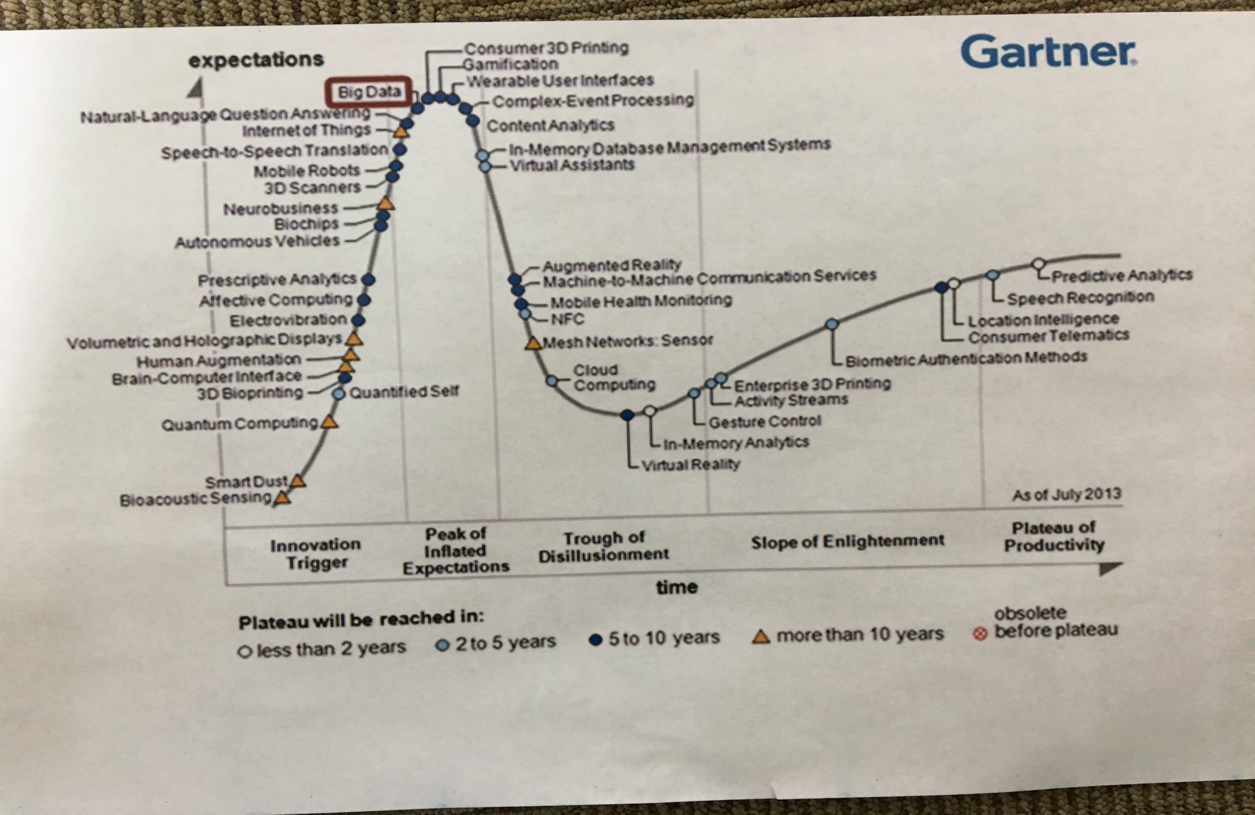
Gartner Hype Curve

Slide 4
Data Management History
1950’s: Individual files, proprietary formats
1960’s: COBOL becomes standard business process language
      “Data division” in program used to define individual files
1960’s: Database management systems introduced. Data defined and managed independent of the application programs that used it.
1969: Introduction of the Relational database model (Codd). Theoretically derived concepts of “normalization” to reduce redundancy and update and delete “anomolies”
1970’s: Widespread adoption of the relational model for operational processing
1980’s: Data warehouses: Large repositories of an organization’s data. Data from extracted, transformed and loaded (ETL) from operational database into the data warehouse. Formatted in a “Star Schema” (non-normalized ) for optimal querying.
1990’s: Data mining and Knowledge Discovery in Databases (KDD) – discovering patterns in data.
2000’s: Explosion of data: business transactions on web and in social networks such as twitter and facebook.
-- EXTRACTING MEANING FROM DATA IS THE MAIN CHALLENGE

Slide 5
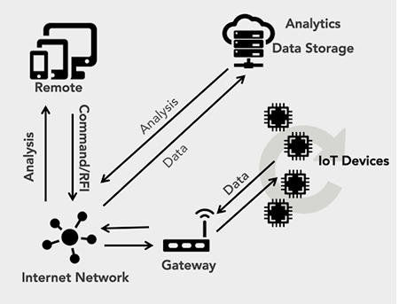
Data Management History (ctd)
Internet of Things (Gartner)
Internet-connected objects able to collect and exchange data using embedded sensors: 25 billion smartphones, tablets, PCs, smartwatches, connected TVs, surveillance devices, household appliances, medical devices, wearables.
Cognitive Computing & A.I.
Big Data: improved decision capabilities afforded by broad and cheap access to very large data sets & new statistical and machine learning
Cognitive Computing: technologies that simulate and augment human decision making capabilities and have the ability to learn from experience.
Blockchain
A shared, serial, distributed ledger for recording trusted reliable incontrovertible transactions. The basis for bitcoin & other crypto-currencies.
-- WHAT IS THE MAIN CHALLENGES NOW?

Slide 6
Big Data (http://www.whatsabyte.com/
1 Bit = Binary Digit
8 Bits = 1 Byte
1024 Bytes = 1 Kilobyte
1024 Kilobytes = 1 Megabyte
1024 Megabytes = 1 Gigabyte
1024 Gigabytes = 1 Terabyte
1024 Terabytes = 1 Petabyte
1024 Petabytes = 1 Exabyte
1024 Exabytes = 1 Zettabyte
1024 Zettabytes = 1 Yottabyte
1024 Yottabytes = 1 Brontobyte
1024 Brontobytes = 1 Geopbyte
© E. A. Stohr, 2013
Notes:
Megabytes, Gigabytes, Terabytes... What Are They?
These terms are usually used in the world of computing to describe disk space, or data storage space, and system memory. For instance, just a few years ago we were describing hard drive space using the term Megabytes. Today, Gigabytes is the most common term being used to describe the size of a hard drive. In the not so distant future, Terabyte will be a common term. But what are they? This is where it gets quite confusing because there are at least three accepted definitions of each term.
According to the IBM Dictionary of computing, when used to describe disk storage capacity, a megabyte is 1,000,000 bytes in decimal notation. But when the term megabyte is used for real and virtual storage, and channel volume, 2 to the 20th power or 1,048,576 bytes is the appropriate notation. According to the Microsoft Press Computer Dictionary, a megabyte means either 1,000,000 bytes or 1,048,576 bytes. According to Eric S. Raymond in The New Hacker's Dictionary, a megabyte is always 1,048,576 bytes on the argument that bytes should naturally be computed in powers of two. So which definition do most people conform to?
When referring to a megabyte for disk storage, the hard drive manufacturers use the standard that a megabyte is 1,000,000 bytes. This means that when you buy an 80 Gigabyte Hard drive you will get a total of 80,000,000,000 bytes of available storage. This is where it gets confusing because Windows uses the 1,048,576 byte rule so when you look at the Windows drive properties an 80 Gigabyte drive will report a capacity of 74.56 Gigabytes and a 250 Gigabyte drive will only yield 232 Gigabytes of available storage space. Anybody confused yet? With three accepted definitions, there will always be some confusion so I will try to simplify the definitions a little.
The 1000 can be replaced with 1024 and still be correct using the other acceptable standards. Both of these standards are correct depending on what type of storage you are referring

Slide 7
Big Data
Bit: A Bit is the smallest unit of data that a computer uses. It can be used to represent two states of information, such as Yes or No.
Byte: A Byte is equal to 8 Bits. A Byte can represent 256 states of information, for example, numbers or a combination of numbers and letters. 1 Byte could be equal to one character. 10 Bytes could be equal to a word. 100 Bytes would equal an average sentence.
Kilobyte: A Kilobyte is approximately 1,000 Bytes, actually 1,024 Bytes depending on which definition is used. 1 Kilobyte would be equal to this paragraph you are reading, whereas 100 Kilobytes would equal an entire page.
Megabyte: A Megabyte is approximately 1,000 Kilobytes. In the early days of computing, a Megabyte was considered to be a large amount of data. These days with a 500 Gigabyte hard drive on a computer being common, a Megabyte doesn't seem like much anymore. One of those old 3-1/2 inch floppy disks can hold 1.44 Megabytes or the equivalent of a small book. 100 Megabytes might hold a couple volumes of Encyclopedias. 600 Megabytes is about the amount of data that will fit on a CD-ROM disk.
Gigabyte: A Gigabyte is approximately 1,000 Megabytes. A Gigabyte is still a very common term used these days when referring to disk space or drive storage. 1 Gigabyte of data is almost twice the amount of data that a CD-ROM can hold. But it's about one thousand times the capacity of a 3-1/2 floppy disk. 1 Gigabyte could hold the contents of about 10 yards of books on a shelf. 100 Gigabytes could hold the entire library floor of academic journals. of Congress. That's a lot of data.
Terabyte: A Terabyte is approximately one trillion bytes, or 1,000 Gigabytes. There was a time that I never thought I would see a 1 Terabyte hard drive, now one and two terabyte drives are the normal specs for many new computers. To put it in some perspective, a Terabyte could hold about 3.6 million 300 Kilobyte images or maybe about 300 hours of good quality video. A Terabyte could hold 1,000 copies of the Encyclopedia Britannica. Ten Terabytes could hold the printed collection of the Library

Slide 8
Big Data (cont’d)
Petabyte: A Petabyte is approximately 1,000 Terabytes or one million Gigabytes. It's hard to visualize what a Petabyte could hold. 1 Petabyte could hold approximately 20 million 4-door filing cabinets full of text. It could hold 500 billion pages of standard printed text. It would take about 500 million floppy disks to store the same amount of data.
Exabyte: An Exabyte is approximately 1,000 Petabytes. Another way to look at it is that an Exabyte is approximately one quintillion bytes or one billion Gigabytes. There is not much to compare an Exabyte to. It has been said that 5 Exabytes would be equal to all of the words ever spoken by mankind.
Zettabyte: A Zettabyte is approximately 1,000 Exabytes. There is nothing to compare a Zettabyte to but to say that it would take a whole lot of ones and zeroes to fill it up.
Yottabyte: A Yottabyte is approximately 1,000 Zettabytes. It would take approximately 11 trillion years to download a Yottabyte file from the Internet using high-power broadband. You can compare it to the World Wide Web as the entire Internet almost takes up about a Yottabyte.
Brontobyte: A Brontobyte is (you guessed it) approximately 1,000 Yottabytes. The only thing there is to say about a Brontobyte is that it is a 1 followed by 27 zeroes!
Geopbyte: A Geopbyte is about 1000 Brontobytes! Not sure why this term was created. I'm doubting that anyone alive today will ever see a Geopbyte hard drive. One way of looking at a geopbyte is 15267 6504600 2283229 4012496 7031205 376 bytes!

Slide 9
BIG DATA (cont’d)
Business Data Cloud Project
 | Started | Laptop Technology Complete | AWS Technology Complete | Tutorial Complete | Tech and Tutorial Tested | Data Sets, Notes, Etc.
Software
MongoDB | yes | yes | yes | yes | Yes
Kafka | yes | yes | yes | yes | Yes
Cassandra | yes | yes | yes | yes | Yes
Kinesis | yes | yes | yes | yes | Yes
RDBMS (Postgres) | yes | yes | yes | yes | Yes
Datasets
NJEdge Internet 2 |  |  |  |  |  | Available
COVID Newsfeed |  |  |  |  |  | Available
NYC City Bike |  |  |  |  |  | Available
Retail dataset |  |  |  |  |  | Available
© E. A. Stohr, 2013

Slide 10
Process Improvement History
1980’s: Total Quality Management (TQM) Demming, Toyota, ..
Incremental process improvement
1990’s: Business Process Reengineering (BPR) Hammer, Davenport, ..
Revolutionary process improvement
1995 ->: Managerial/Collaborative Work (CSCW) Flores, Group DSS ..
Decision support, flexible non-repetitive processes
1997 ->: Learning Org., Knowledge Management Prusak, Davenport, ..
Learning processes, knowledge sharing, intangibles
2001 ->: Business Process Management (Smith, others)
Broader view of BPR – includes planning, controlling and
monitoring activities
2003 ->: Social networks
Blogs, Wikis, Twitter, mobile apps)
Notes:
Each movement is a product of its time
TQM, Japan - emphasis on quality, stable processes that chould be continuously improved.
1990’s - a recession in U.S. - BPR was the right medicine. Unfortuantely it became associated with “down sizing”. There is a sense that excessive downsizing destroys the people-related competence of a firm. Still, process design is a major activity of all companies today - moving to inter-organizational process design - supply chain, etc.
CSCW (Computer Support for Collaborative Work) - recognition that much work is non-routine - and is performed by groups or teams. Group DSS (software that enables electronic brainstorming)
KM - recognition that non-tangible assets (e.g. a firm’s knowledge) is a key to its success.

Slide 11
Process Improvement History (ctd)
Some important technologies (1990 – present):
Workflow Management Systems: software that allows work to be passed electronically from workstation to workstation according to rules.
Business Process Rules Management. Representing and executing business rules outside of program code.
RPA
Business Process Management Notation. A standardized process representation. BPMN
Complex Event Processing. Systems that monitor multiple events to detect situations that require action.
Process Mining. Discovering process execution patterns in workflow logs.
Blockchain. Developing reliable peer-to-peer trading platforms in many different industries.

Slide 12
Business Process Management
Business Process Management is an IT-enabled management discipline that:
  Requires a shift to process thinking and away from traditional functional structures
  Includes all the things around the process that helps realize the goals of the organization
  Covers the complete process life cycle analysis, design, implementation, monitoring and improving via continuous feedback
Stages in the growth from BPR to BPM:
  Productivity: Gains 15- 150% by supporting work reducing paper
  Visibility/Flexibility: managing processes across the organization and with external partners, compliance
  New ways of doing business for the firm and industry
From Gartner Business Process Management Summit, 2007

Slide 13
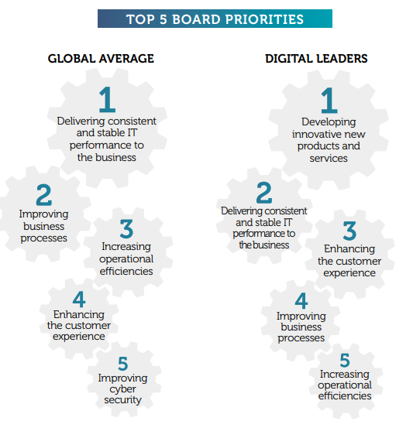
Top IT Priorities
cio-survey-harvey-nash-2019-full-report

Slide 14
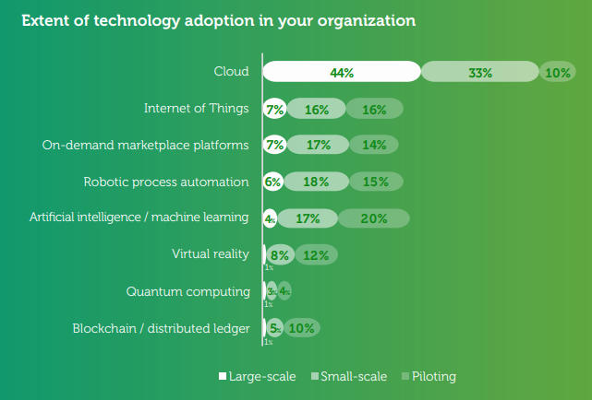
New Technology Adoption
cio-survey-harvey-nash-2019-full-report

Slide 15
Organizational and Management Processes David Garvin, SMR 1998
A unified framework for thinking about processes
An integrated, dynamic, picture of organizations and managerial behavior
Organizational processes
  Work processes ---> focus on quality, productivity, BPR
  Behavioral processes ---> focus on shared patterns of behavior
  Change processes ---> focus on sequence of events over time
Managerial processes
  Direction-setting ---> charting a course, mobilizing resources and support, ensuring alignment with stated goals
  Negotiating & Selling ---> Horizontal (Negotiating); Vertical (Selling)
  Monitoring & Controlling ---> oversight, detect perturbations, corrective action, restore equilibrium

Slide 16
Org Process Framework Garvin
 | Work | Behavioral | Change
Definition | Sequence of activities that transform inputs into outputs | Shared patterns of behavior and ways of acting & interacting | Sequence of events over time
Role | Accomplish work | Infuse and shape the way work is conducted by influencing how individuals & groups behave | Alter scale, character, and identity of org
Design | Artifacts: process map, relationship map | Diagnosing and changing culture | Diagnosing & overcoming resistance
Major Categories | Operational Administrative | Individual Interpersonal | Autonomous & induced; incremental & revolutionary
Examples | New product development, order fulfillment, strategic planning | Decision making, communications, organizational learning | Creation, growth, transformation, decline
Notes:
Work processes have their antecedents in
- TQM: measurement and control; continuous improvement
- Reengineering: radical change
Work processes can classified as:
- Operational – provide service or products to customers
- Administrative – exist to enable the operational processes
These are linked. E.g. logistics and forecasting supports SCM
Strategy and planning support NPD
Overall healthy impact on organizations because they force an integrative view
Failure – in part because there is more than just process change involved – also organizational structure and coordination and control have to be managed.
Behavioral Processes roots in organizational theory; cognitive & interpersonal aspects of work. (e.g. 2 NPD processes in different organizations may have the same steps (e.g. stage cycle) but be completely different – because of the behavioral processes.
Decision making processes – not sequential (search, design, choice)
Communication Processes – how indivs and groups share info and agree on agendas and goals, for example. Two types of communication processes: directing work and maintaining cohesion

Slide 17
Managerial Process Framework Garvin
 | Direction-Setting | Negotiation & Selling | Monitoring & Control
Purpose | Establish organizational direction and goals | Obtain needed support and resources | Track ongoing activities and performance
Primary Task | Developing an agenda | Building a network | Collecting information
Critical Skills | Synthesis, priority setting, communication | Timing & sequencing; Framing & presentation | Questioning & listening; Interpreting data
Notes:
Learning Processes: knowledge acquisition, interpretation, dissemination and retention
Change Processes – Darwinian or induced episodic change
Creation, growth, transformation and decline

Slide 18
Framework for Action Garvin
Organization Processes
Management Processes | Work | Behavioral | Change
Direction-Setting | Are there clear goals for operational and strategic performance? | Are there well-specified approaches to communication, decision-making, and learning? | Is there a clear rationale, direction, and path of change?
Negotiation & Selling | Have we obtained the necessary agreements, and resources, from upstream and downstream departments? | Is there widespread acceptance of the desired approaches to communication, decision-making, and learning? | Are others in the organization convinced that change is needed and that change the proposed changes are the right ones?
Monitoring & Control | Do we know how well our performance matches plans? | Do we know how well our current behaviors match to desired communication, decision-making, and learning? | Do we know whether critical milestones have been reached and planned changes have been implemented?

Slide 19
Part II: PRODUCTIVITY
AND EFFICIENCY
Raising the productivity of knowledge workers is the
greatest challenge facing management and raising the
productivity of service workers and knowledge workers
is the greatest challenge facing society (Peter Drucker)

Slide 20
Knowledge & Service Work
Definition and Breakdown
Services are consumed as they are produced. There is often a direct encounter between the provider and the consumer.
Business services: Consulting, finance, banking
Trade services: Retailing, maintenance and repair
Infrastructure services: Communications, transportation
Social/personal services: Restaurants, health care
Public administration: Education, government
70% Knowledge work: Professional/technical; Managers; Officials; Proprietors; Clerical; Sales; Educators
30% Other services: Private household workers; other

Slide 21
Work Force Trends
Fitzsimmons & Fitzsimmons, Service Management for Competitive Advantage, McGraw-Hill,1993
Composition of the Work Force
Agricultural workers - 2%
Factory workers - 18%
Information workers - 45%
Knowledge workers - 12%
Other service workers - 23%
Over 75% of the work force was outside of manufacturing and agriculture.
A service is a time-perishable, intangible experience performed for a customer acting in the role of a co-producer. (FITZSIMMONS & FITZSIMMONS 2003).
Notes:
What was the distribution like in the 19th Century?
What will the distribution of work look like in 20 years?
Can we continue to employ large numbers of information and knowledge workers?
The extract below is from CIA World Factbook (2006):
farming, forestry, and fishing 0.7%,
manufacturing, extraction, transportation, and crafts 22.9%,
managerial, professional, and technical 34.7%,
sales and office 25.4%,
other services 16.3%
note: figures exclude the unemployed (2005)

Slide 22
Information & Knowledge Workers
An information worker tends to work with data and information. They create and consume, but don't transform or manage information. They make information available.
A knowledge worker applies expertise to information to create products, make decisions, etc. based on the expertise of the subject material they are responsible for. These are people within the organization that poses the talent of converting information to knowledge.
Information workers’ work can be automated with the advancement in technology and availability of new tools and system. However, knowledge workers are not easily replicable as they add value to the information and make information more than just noise. This job is not replicable by the technology and systems as there is a critical thinking component which cannot be automated.
Davenport (2005, p. 4) says that the rise of knowledge work has actually been foreseen for years. This is because there is strong linkage between knowledge workers and innovation. Knowledge workers engage in knowledge sharing across organizational and company boundaries, forming a network of expertise. There is a high focus on life-long learning over life-long employment.

Slide 23
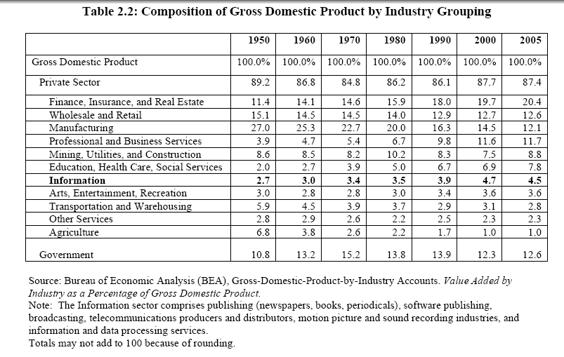
Composition of Gross Domestic Product

Slide 24
Productivity Trends
Fitzsimmons & Fitzsimmons, Service Management for Competitive Advantage, McGraw-Hill,1993.
U.S. Productivity growth over the last 10 years:
Farming - 2.04% per annum
Manufacturing - 2.75%
Finance & real estate - 0.17 %
Wholesale and retail trade - 1.15 %
Productivity in service and knowledge work has historically been much lower than in farming, manufacturing and transportation.
There are signs of a turn-around in the last few years.
Is this due to IT? To TQM? To Reengineering?
The cost of a teller transaction at a bank is $1.07,
The cost of a similar online banking transaction is $.01
The productivity literature in the last decade points to a virtually unanimous conclusion – information technology directly or indirectly accounts for the lion’s share of the resurgence of productivity in the United States since 1995.
Notes:
Latest U.S. Productivity Figures:
NYT “Notions of New Economy Hinge on the Pace of Growth” Sep 2001.
Overall productivity for 1999-2000 has been revised down (from 3.4% to 2.6%)
Productivity is the engine of economic growth without inflation and with full employment. The government is relying on this to finance the surplus.
NYT “Americans’ International Lead in Hours Worked”
Productivity growth slower in knowledge work?

Slide 25
Defining & Measuring Productivity
Productivity is an efficiency (rather than an effectiveness) concept.
Productivity = Output quantity/Input quantity= O/I
where O and I vary with the application. Examples:
GDP per person, value added per labor hour, etc.
Note that O and/or I can be multidimensional:
Productivity = O/(L + C + R + Q)
where L = labor, C = capital, R = raw materials and Q = miscellaneous goods and services. In this case, all of the inputs are in monetary terms.
Profitability can be related to productivity as follows:
Profitability = Productivity x Price recovery
= (O/I) x (P_{o}/P_{i})
where P_{o} = output price index, P_{i} = input price index
Notes:
Productivity doesn’t matter if you are not profitable?

Slide 26
Economist’s Viewpoint
Input Efficiency
The firm is optimally using the factors of production
Allocative Efficiency: Inputs are combined in optimal proportions
Technical Efficiency: No more of each input is used than should be required to produce a given level of output
Output Efficiency
The firm produces the correct combination & level of outputs.
Scale efficiency: The firm maximizes the ratio of outputs to inputs.
Scope efficiency: The firm jointly produces two or more outputs more efficiently than it could produce each of the outputs separately.
Notes:
Allocative Efficiency: Occurs when inputs are combined in optimal proportions e.g. an efficient high tech (capital intensive) firm uses a lot less labor than a low tech firm.
Scale efficiency: Occurs when a firm is operating at a level that maximizes the ratio of outputs to inputs.
If there are increasing returns to scale, then the firm should produce more (if the market allows) (and vice versa for decreasing returns). If we assume constant returns to scale, output efficiency and technical input efficiency coincide.
Scope efficiency: Occurs when the firm jointly produces two or more outputs more efficiently than it could producing each of the outputs separately.
Which efficiency is addressed by a merger with a similar firm?
Which efficiency does BPR address?
Which dot-com is using scope efficiency?
Are there any other ways in which a firm can become more efficient?

Slide 27
Defining & Measuring Productivity
Suppose firm A only produces Y1 < Y2:
(it should produce Y2 for these inputs)
Technical efficiency = OB/OA
X2
Y2
Y1
X2a
A
B/p2
X2b
B
Firm E is efficient (it attains the highest level of output given prices p1 and p2 and total budget, B)
E
X2e
O
X1b
X1e
X1a
B/p1
X1
© E. A. Stohr, 2006

Slide 28
Data Envelopment Analysis
There are many similar productive units (e.g. bank branches, franchise restaurants, hotels in a chain).
Each unit has several different inputs and outputs.
Which units are the most efficient?
How can we improve inefficient units?
Data Envelopment Analysis (DEA) uses linear programming techniques to find the “best practice” firms or productive units. For each firm, we find “reference firms” - the firms that are most like it in terms of input mix and are, relatively, the most efficient. These efficient firms lie on the “efficiency frontier”. Firms that do not lie on this frontier are considered inefficient and their inefficiency is measured by their distance from the frontier (e.g. distance AB in the previous figure).

Slide 29
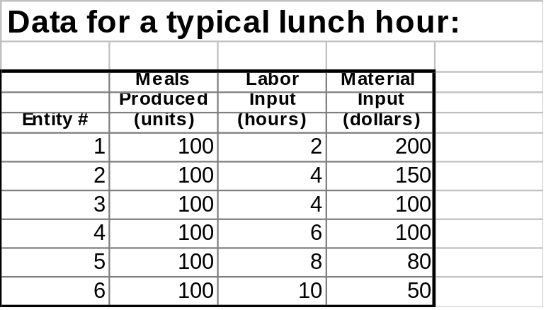
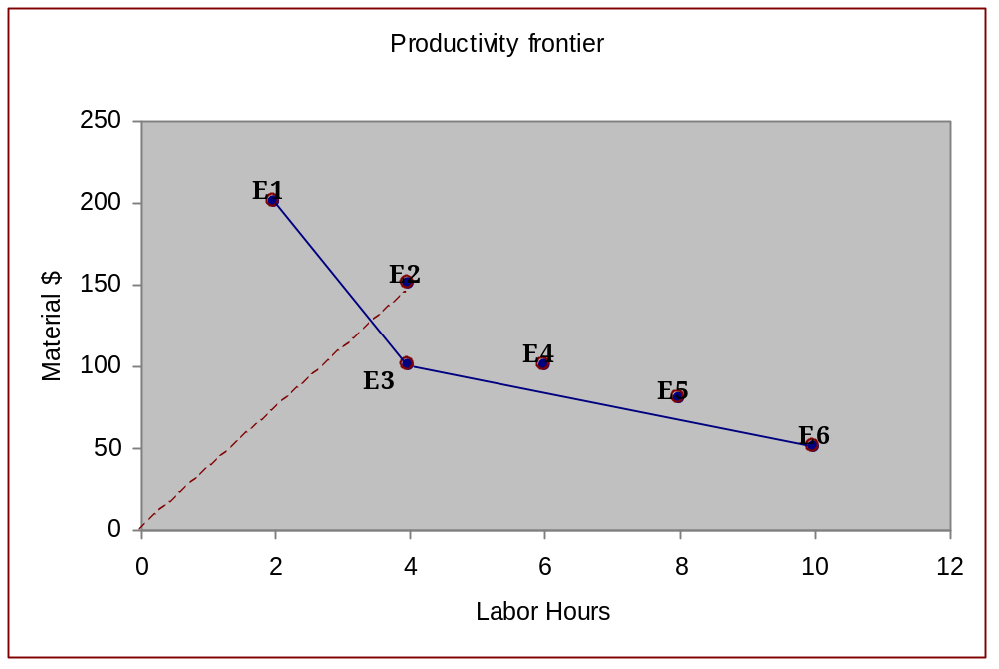
Data Envelopment Analysis
Burger Palace Example
Technical efficiency of E2 = OE*/OE2 (<1)
Efficiency Frontier
E*
Notes:
Production frontier = efficiency frontier
Note that the efficiency frontier is an empirical concept. If data is collected on hundreds of firms, the efficiency frontier can be approximated by a smooth curve.
DEA assumes that “smooth” trade-offs can be made – i.e., that an inefficient firm can make itself more efficient by decreasing the different types of input in the correct proportions to move it onto the efficiency frontier.

Slide 30
The Learning Curve
The more times a task has been performed, the less time (and cost) will be required on each subsequent iteration. Wright-Patterson Air Force Base in 1936 every time total aircraft production doubled, the required labor time decreased by 10 to 15 percent.
“80% Learning Curve”
(Time shorter by 20% every time output doubles)
Average Time (Hours)
Cumulative Output (Units)

Slide 31
Accountant’s Viewpoint - ABC
Use standard cost accounting techniques for financial statements. These were designed to compute inventory valuation (balance sheet) and cost of goods sold (income statement). Unfortunately, these systems assign all overhead costs (supervision, depreciation, space costs, etc.) to products on the basis of the single “cost driver” - direct labor hours. However:
Direct labor may only represent a small proportion of product cost
Some activities/products may require much higher indirect costs
(overhead) than others (e.g., space or supervision varies.)
Use activity-based cost accounting (ABC) to more accurately assign costs to cost objects such as processes, products, services, departments, customers
Notes:
ABC does not change the way direct costs are allocated
Conventional cost accounting - often allocate the largest cost (overhead) on the basis of the smallest (direct labor)
Financial accounting - for external reporting -> managers may make wrong make-buy and product-mix decisions. Worse in service firms ...

Slide 32
ABC Definitions
ABC assigns costs to activities based on their use of resources and assigns costs to cost objects based on their use of activities.
Direct resources costs are traceable to the cost object
(e.g., materials & labor for a product)
Indirect costs are not traceable to individual cost objects & must be assigned to cost objects using some averaging process
(e.g., supervision, administration, building rental for a product)
There are different indirect cost accumulation pools for each cost object
A Cost driver is any factor (or activity) whose change will cause a change in the total costs of a cost object. A cost object may have many cost drivers.
Pooled costs are allocated to each cost object using the associated cost drivers.

Slide 33
ABC Stage 1 - Example Step 1
Stage 1 transition to ABC: Set up “cost pools”
Objective: Compute the total (ABC) cost per unit of each product
Indirect Costs
Supervision
$1000
Electricity
$1500
Cooling Fluids
$2000
Rags
$200
Regression analysis?
+
+
Cost Pools
Dir.labor-related
$7500
Material-related
$4400
+ $750
+ $350
+ $1750
+ $1500
+ $1750
+ $1100
Services
Space
$2250
IT
$2100
HR Support
$3850
Notes:
The original data shown comes from standard costing systems. All this step does is aggregate costs for an average week of operation into the cost pools.
Indirect Costs - the determination that Supervision and Electricity use should be allocated on the basis of DL and the others on the basis of material usage might be determined by common sense or regression, for example.
Services (overhead) - the allocations here are done on the basis of deeper investigation. For example, space might be allocated to DL and Material on in proportion to the space devoted to manufacturing and warehousing.

Slide 34
ABC Stage 1 - Example Step 2
Cost Pools
Dir.labor-related
$7500
Material-related
$4400
$7500/ 500 = $15 /hr
$4400/220 = $20 /kg
Products/
Processes
=Cost Objects
Product P1 P2
Dir.labor (hr/unit) 5 10
Materials (kg/unit) 5 3
P1
P2
$10 /hr
$15 /kg
Direct Costs
Direct labor
500 hours used
Direct material
220 kg used
Product Cost per unit of P1:
Labor: 5 x ($10 + $15) = $125
Material: 5 x ($15 + $20) = $175
Total Cost: $300
Product Cost per unit of P2:
Labor: 10 x ($10 + $15) = $250
Material: 3 x ($15 + $20) = $105
Total Cost: $355
Notes:
Having calculated the total costs in the cost pools, it is now a simple matter to allocate the overhead to the product on the basis of the cost drivers DL/hour and kg/unit of product. Note that DL usage of 500 hours/week and material usage of 220 kg/week comes from historical records.
Note:
This example is trivial – there is only one process – so the total overhead is allocated to it.
ABC is of interest when there is more than one process. A problem with multiple process will be assigned as a homework exercise.

Slide 35
ABC Stage 2 - Model
Stage 2 transition to ABC: Use Activities/Activity centers
Objective: Compute the total (ABC) cost per unit of each product
Resources
Resource
Drivers
Activity
Drivers
Cost
Objects
Example:
R & D %Time Design # of Product
Dept. Components
Activities
Note: The use of ABC accounting techniques for making decisions about products is somewhat controversial
ABC is quite complex and difficult to execute in practice
Better decisions may require a different, incremental costing, approach taking the whole system into account e.g., use linear programming model or the Theory of Constraints (see later)
Notes:
This is a schematic view of the full ABC model ..

Slide 36
ABC Process Costing – Example
Compute the full cost per transaction for the following process. The average costs per week for supplies, building support and computers are as shown in the diagram. The process produces 100 transactions per week.
$ 2400
Salaries
$1200
Building
$1500
Computers
Resources
Resource cost drivers
Overhead
Activity Centers
Dept 1
Dept 2
(Departments)
Activity cost drivers
Process
(= Cost Object)
A1
A2
A3
Measured consumption
Direct
Direct Labor
Supplies
Direct Costs
Activity A1 Activity A2 Activity A3
Labor: $10 $20 $10
Supplies: $5 $1 $2

Slide 37
ABC Process Costing – Example
Handling Overheads:
  Department 2 has twice as many salaried employees (managers) as department 1
  The space (square feet) occupied by each department is approximately the same.
  Department 2 has twice as many computers as department 1.
  Activity A1 and A2 are approximately equal in terms of their management, space, and computing requirements.
Class exercise:
Given the above information compute the fully allocated cost per transaction
Notes:
Process Cost per Transaction:
Activity 1 = 9.5 + 10 + 5 = 24.5
Activity 2 = 9.5 +20 + 1 = 30.5
Activity 3 = 32 + 10 + 2 = 44.0
Total = $99

Slide 38
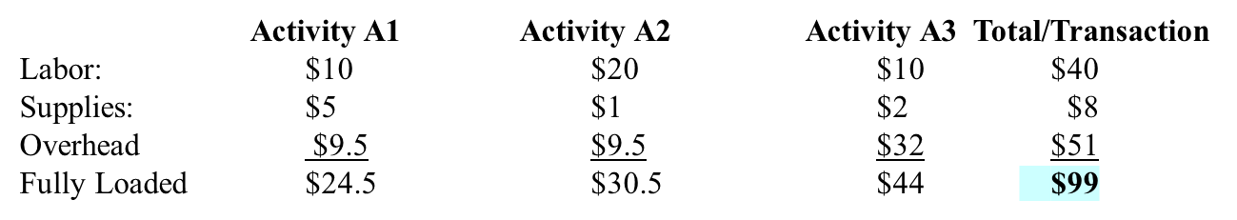
ABC Process Costing – Continued
$ 2400
Salaries
$1200
Building
$1500
Computers
Indirect Resources
$800
$1600
Indirect Dept 1 Dept 2
Salaries: $800 $1600
Building: $600 $600
Computers $500 $1000
Total Indirect $1900 $3200
Total per Transaction $19 $32

Slide 39
Financial Viewpoint - EVA
The goal of the corporation should be to maximize shareholder value. One way to evaluate a firm’s performance is to use accounting measures such as return on equity, return on assets, etc.
However, these accounting measures fail to take into consideration the cost of capital faced by the company.
Economic value-added (EVA) for a firm:
EVA = Operating income - Taxes – Cost of capital Where: Cost of capital) = CCR x TCE
CCR = Cost of capital rate
= weighted sum of cost of debt & cost of equity
    Cost of debt = risk free rate + company risk premium = 9% (say)
    Cost of equity = risk free rate + equity risk premium = 15 % (say)
TCE = Total Capital Employed (in firm, product, process, …)
(All $ required to operate including equity, R&D, training, software development, etc.)
Notes:
In corporate finance, we learn that the goal of the corporation should be to maximize shareholder value. One way to evaluate a firm’s performance is to use accounting measures such as return on equity, return on assets, etc. Accounting measures of performance fail to match cash profits with cash invested by the company. In that sense, accounting measures fail to take into consideration the cost of capital faced by the company.
Turning to the financial viewpoint. Some authors advocate the use of EVA to determine the value a process. EVA is equivalent to ROI or PV analysis. EVA for a firm can be computed directly from its financial statements.
See George Pinteris: http://www.business.uiuc.edu/gpinteri/eva.pdf
EVA is a measure of performance that shows the net contribution to value by a company’s investment decisions. This measure is given by subtracting from the net income after taxes the cost of capital invested in the company. We call this measure the Economic Value Added (EVA) and we calculate it as follows:
EVAt = NOPATt – (WACC × Invested Capitalt-1)
In this calculation, NOPAT is the net operating profit after taxes and WACC is the company’s weighted-average cost of capital. Defining (NOPAT/Invested Capital) as the company’s Return on Invested Capital (ROIC), we can write the above formula again as follows:
EVA = (ROIC – WACC) × Invested Capital
This formula of EVA shows that a company’s investment decisions create value when they generate after-tax returns that are above the cost of the capital invested in the project.

Slide 40
EVA (continued.)
EVA must be positive if the stockholders are to receive a positive return. Hence, projects and process improvements should not be undertaken unless their EVA > 0.
EVA is a better measure than accounting profit. (If managers try to maximize the growth rate of earnings, they may invest in projects that offer very low rates of return.)
At the firm level, EVA can be computed from financial statements and seems to track the stock price better than profits
EVA gives the same relative results as NPV (net present value of discounted cash flows of the firm)
Conclusion for Process Reengineering:
Include the cost of capital when evaluating the full cost of a process improvement project.
Notes:
From George Pinteris: http://www.business.uiuc.edu/gpinteri/eva.pdf
EVA is a better measure of performance for the following reasons:
• EVA provides insight into the factors that drive value creation: cash flows and risk.
• EVA allows one to actually quantify value created or destroyed and to obtain a magnitude of returns given by the (ROIC – WACC) spread.
• EVA can provide a clearly defined yearly account of value created or destroyed. Managers can improve EVA by increasing earnings or reducing the cost of employed capital.
• EVA can also be used as a company valuation tool. This is because a company’s market value is equal to the sum of the capital invested and the present value of future EVAs.

Slide 41
EVA (continued)
What categories of costs need to be considered when estimating the cost of investment in a BPR improvement project?
1. Direct costs (labor + materials + power + office supplies + ..)
2. Indirect costs (training + HR + IT expenses + supervision + ..)
Some processes may require higher relative training or supervision expenses than others, etc.
3. Capital investment (facilities + space + computer center + ..)
A study has to be made to compute the firm’s capital investment in a process)
Process Value:
Hard to estimate in an absolute sense. However, we can use the
EVA concept to estimate the increase in value obtained from a
process improvement project.
Notes:
What costs have to be accounted for when we perform a process cost-benefit analysis?

Slide 42
ABC-EVA Conceptual Model
Consumes
Direct
Cost
M
N
Consumes
Consumes
Cost Object
Activity
Operating
Cost
M
N
M
N
Consumes
Capital
Cost
M
N
Notes:
This model adds capital cost to ABC costing.

Slide 43
The Productivity Paradox
Moore’s Law:
  The speed of computation doubles every 1 1/2 to 2 years
Telecommunications
Bandwidth in fiber optic media doubles every 2 years
The Internet
Connections on the Internet continue to grow rapidly
(doubling each year in some regions of the world)
Metcalf’s Law
The value to an individual of belonging to a network
increases as the square of the number of connections
These trends will continue in the foreseeable future
Notes:
IT is becoming faster, cheaper, better all the time.

Slide 44
The Productivity Paradox (ctd.)
According to the “paradox”, empirical data shows that:
IT investment has not correlated closely with national and industry measures of productivity
At the level of the firm, results are mixed
Strategic competitive advantage has been hard to sustain:
  Often, market share, rather than profitably, is increased
  Profits can be competed away, with the ultimate
  advantage ensuing to the customer
Notes:
Does the use of IT imply increased productivity? Not according to the “productivity paradox”.
Is there a paradox? What can be the explanation?
(Poor data. Studies at too high a level (economy or industry rater than firm level or even more micro. Too many other explanatory variables.
Example of LT strategic advantage of IT - airline reservation systems, Baxter Healthcare.
Examples of lack of LT strategic advantage - ATM networks gave only a transitory competitive advantage to the first banks. Now it is mandatory. (ATM networks raise barriers to industry.)

Slide 45
Productivity Paradox (ctd.)
What can explain the IT productivity paradox?
Poor data
IT projects are not always successful
Too highly aggregated - impacts of other variables
The impact of IT is better seen at the activity or process level
measurement is easier as there are fewer intervening
variables
How can one include quality?
Some impacts are not measured in dollar terms
e.g., customer satisfaction
Notes:
How does one account for the improvement in our lives from the existence of ATM’s? Who benefits?

Slide 46
Productivity Paradox (ctd)
Beyond Computation: Information Technology, Organizational Transformation and Business Performance, Hitt & Brynjolfsson, 1998
Firm Level Data (rather than macro or industry data) allows greater accuracy in measuring:
- Intangible Costs & Benefits e.g. innovation, quality
(Intangible products of IT often rank higher than cost savings
as motivations for IT investments)
- Organizational Complements
IT is a complement and small fraction of the expense of:
New ways of organizing work e.g., empowerment
New ways of interacting with customers & suppliers
e.g. P&G’s Efficient Consumer Response system (ECR)
- New products and services e.g. Amazon.com
e.g. No. of new product introductions in super markets:
1281 in 1964 to 16,790 in 1992
Complements: Raising the level of one factor increases the value of another

Slide 47
Productivity Paradox (ctd)
Brynjolfsson et al, 1998 Study of 400 Manufacturing Firms:
IT Investment
High
productivity
Contours of productivity
Low
productivity
Medium
productivity
Line responsible for pace of work
Line chooses work processes
Self-managing teams
Education and training
Decentralization
The top quartile of firms in terms of decentralization/empowerment have:
20 % greater investment in IT
25% greater return on IT
Firms that are in the top 1/2 of IT investment and decentralization have 5% greater productivity than firms that adopt neither or decentralization alone.
Notes:
What explains each of the “hills” in this graph?
What kind of firms live on each hill?
Moral: Must change organization components when introducing IT. What this course is all about.

Slide 48
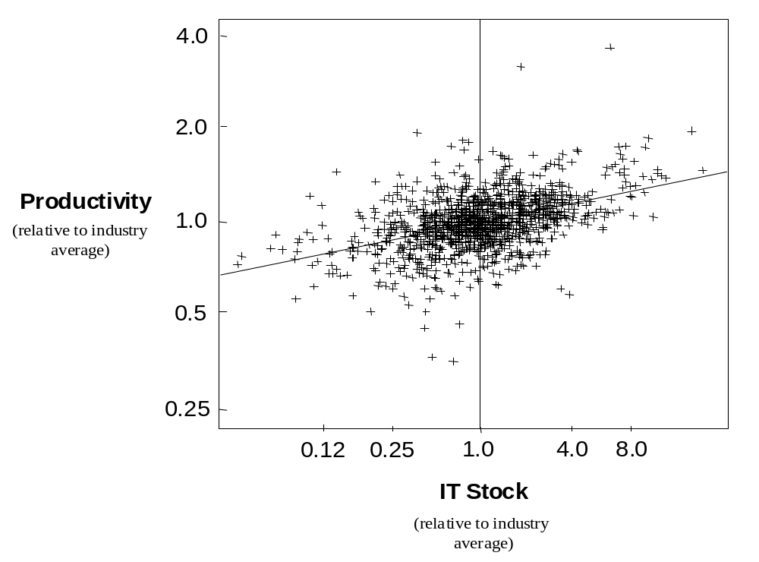
Firm-Level Data
Brynjolfsson et al, 1998 Study of 400 Firms:
Notes:
This shows some support for an increase in productivity as a result of an increase in IT investment. Other explanations?

Slide 49
BPM Bibliography
Davenport, Thomas H., Short, James E. The New Industrial Engineering: Information Technology And Business Process Redesign. Sloan Management Review. Summer 1990. Vol. 31.
Davenport, Thomas. Process Innovation: Reengineering Work through Information Technology. Harvard Business School Press, 1993.
Garvin, David A. The Processes of Organization and Management, Sloan Management Review; Summer 1998; 39, 4.
Hammer, Michael. Reengineering Work: Obliterate Don’t Automate. Harvard Business Review, July 1990.
Hammer, Michael and James Champy, Reengineering the Corporation: A Manifesto for Business Revolution, Harper Business, 1993.
Hitt, L & Brynjolfsson, E. Beyond Computation: Information Technology, Organizational Transformation and Business Performance. Communications of the ACM. 1998.
Varian, H. Information Technology May Cure Low Service-Sector Productivity, The New York Times, Feb 12th, 2004.
Weske, Mathias (2007), Business Process management: Concepts Languages and Architectures. Berlin: Springer-Verlag.

